Slide 1
Information Theory and Coding Project
BER Performance Analysis of Linear Block Codes
Submitted To: Dr. Thanikaiselvan V
Team Members:
Shikhar Chandra - 18BEC0146
Srivathsan V K K - 18BEC0341
Harish K - 18BEC0353

Slide 2
Introduction
Linear Block Codes are error correcting codes having blocks of codewords with added redundant bits.
Examples: Hamming Codes, Hadamard Codes, Repetition Codes Reed-Solomon Codes, Golay Codes etc.
BPSK Modulation, Additive White Gaussian Noise (AWGN)
( 3, 1 ) Repetition Code
( 5, 1 ) Repetition Code
( 7, 4 ) Hamming Code

Slide 3
Block Diagram
Source Information
(Random binary stream)
Channel Coding (Repetition Code / Hamming Code)
Modulation (BPSK)
Channel Noise (AWGN)
Hard Decision Decoding / Soft Decision Decoding
Demodulation
Received
Information

Slide 4
Algorithm
(n,1) Repetition Code:
Give input bits [m-message bits]
Passing the message bit to Repetition Encoder [r=k/n]
Apply BPSK modulation and add AWGN noise.
Estimate code vector by Decision decoding.
Estimate message vector by Hard and Soft Decision decoding.
Analyze the BER performance by comparing estimated message vector with the input message bits.

Slide 5
Algorithm
( n,k ) Hamming Code:
Generator Matrix G = [ I_{k} | P ] ; P = Parity Matrix
Parity Check Matrix H = [ P^{T} | I_{n-k} ]
Codeword C = D*G ; D = Message vector
Syndrome S = R*H^{T} ; R = Received symbols vector
If S = 0 , then No error
Else If S = i, then error at i^{th} bit
Fix single bit error according to Syndrome.

Slide 6
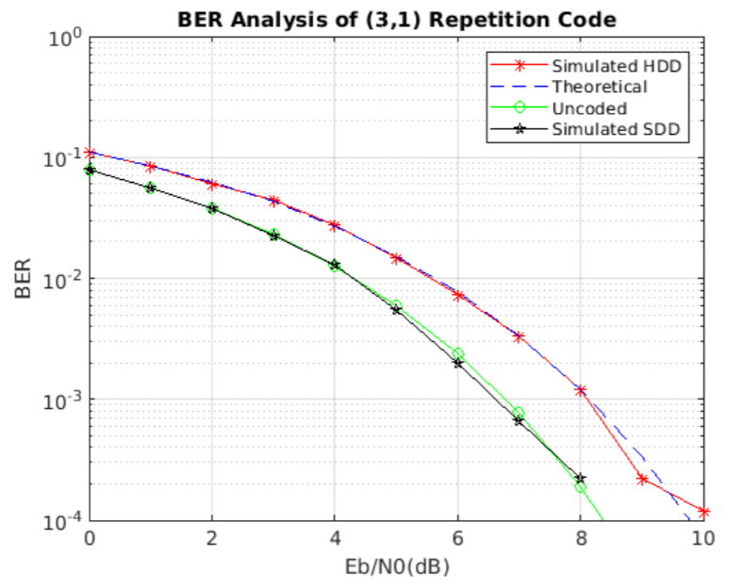
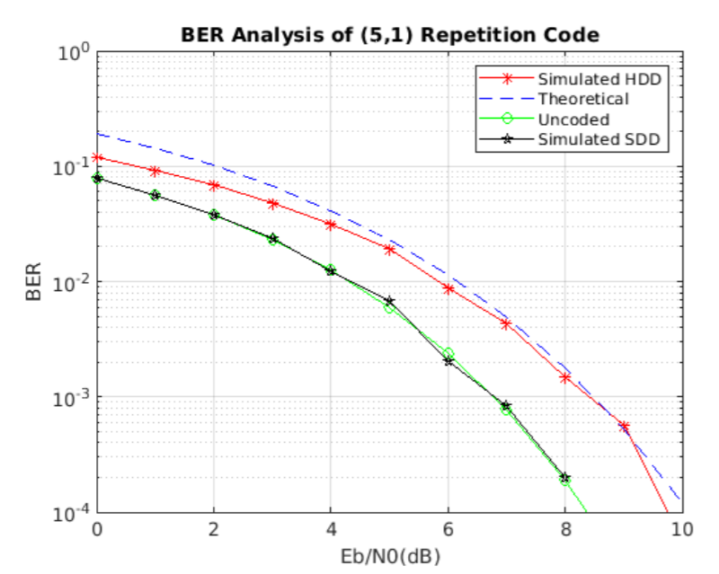
Results

Slide 7
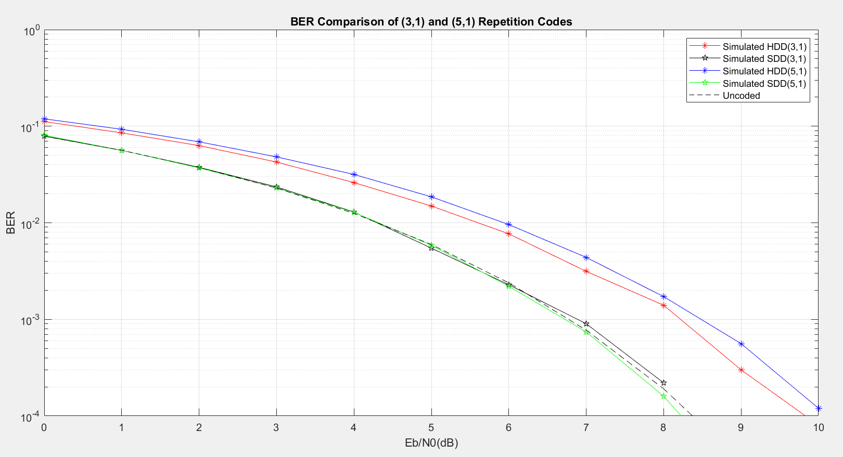
Results

Slide 8
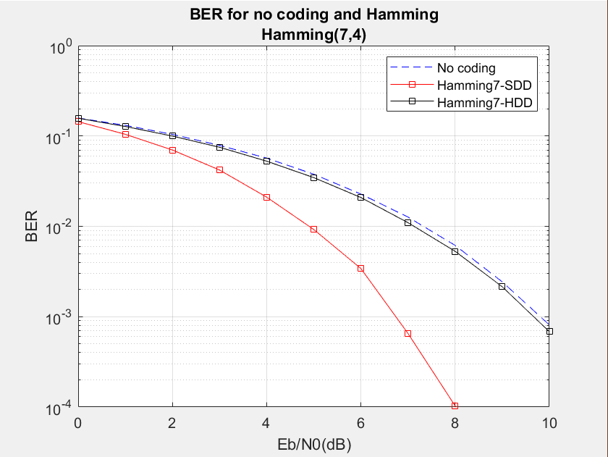
Results

Slide 9
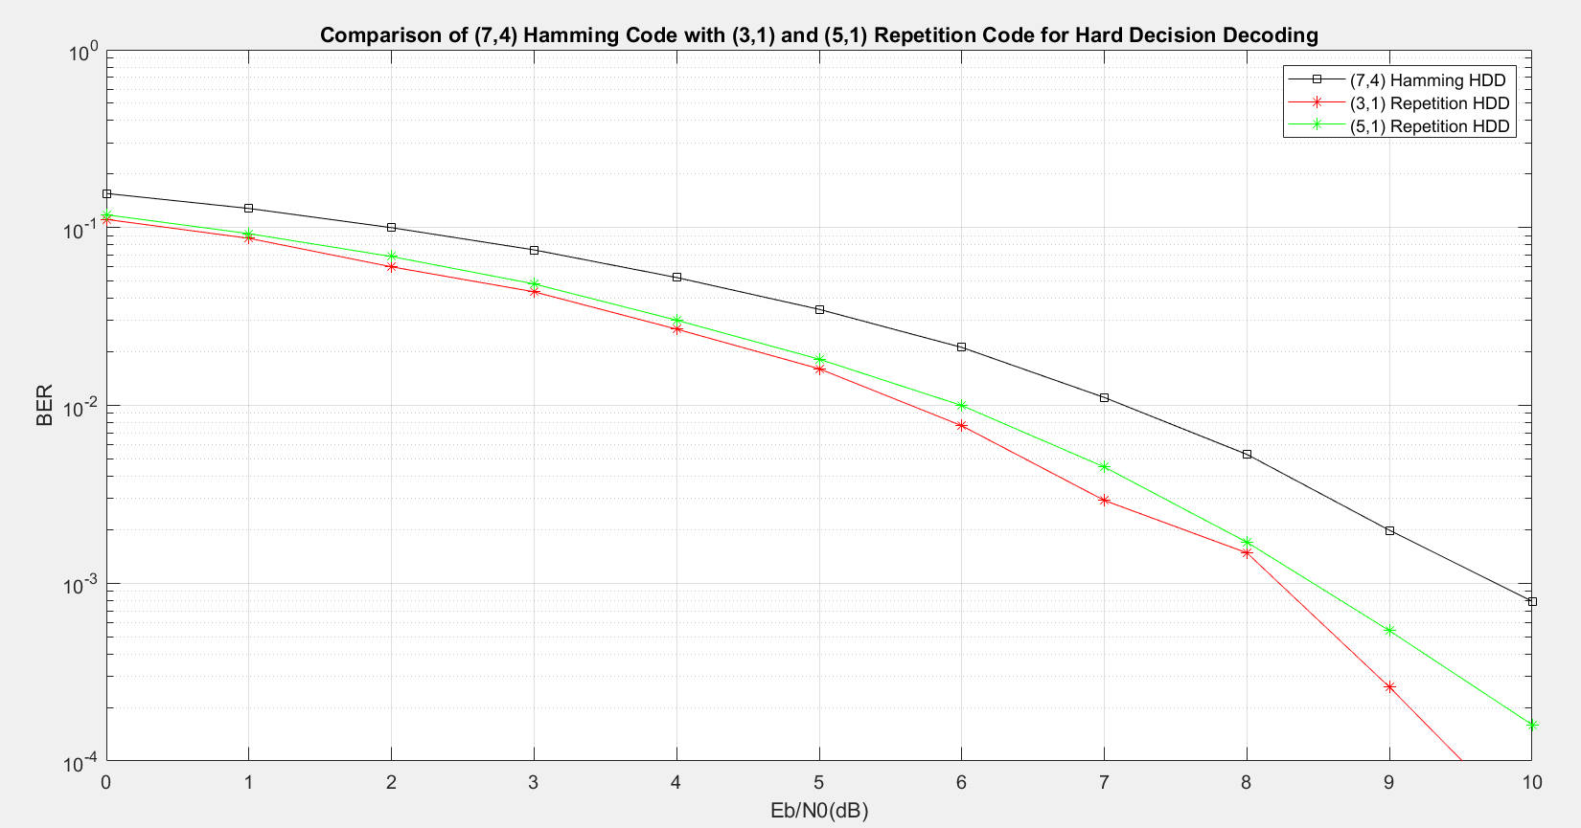
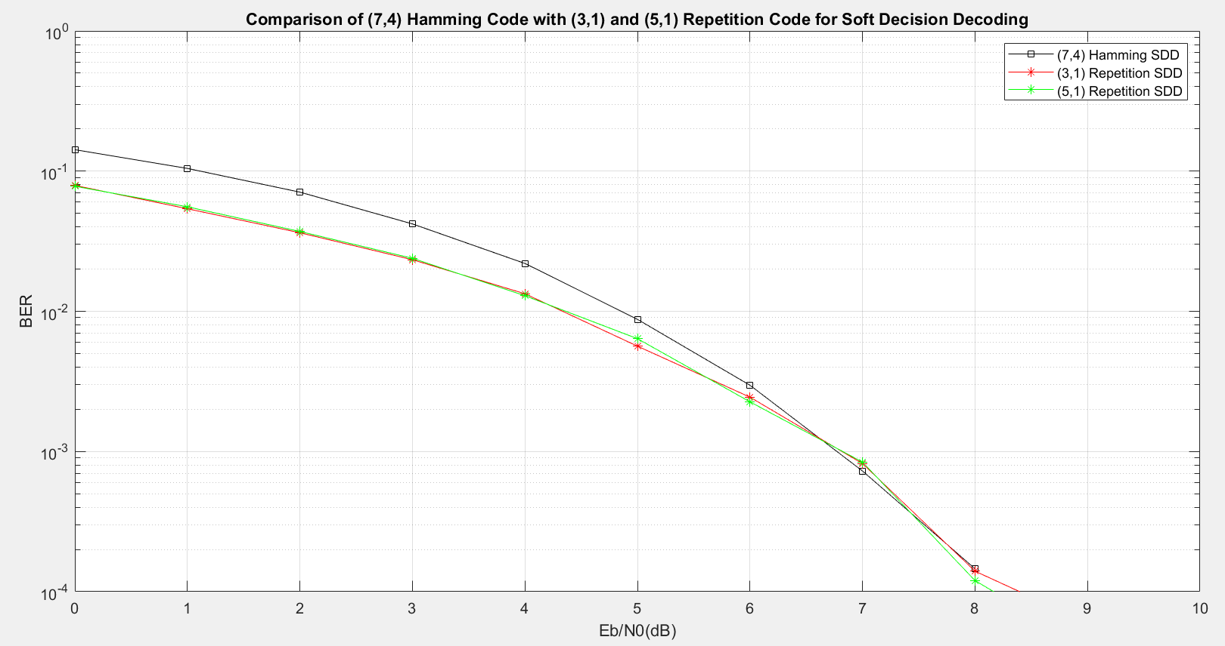

Slide 10
References
1. Kaur, Amandeep & Kaur, Gagandeep & Singh, Navdeep. (2017). A Review: BER Performance Analysis of Linear Block codes used in FEC over AWGN channel.
2. P. R. Kamala and R. V. S. Satyanarayana, "Optimal linear block code modeling and performance analysis over various channels for use in wireless communications," 2016 International Conference on Emerging Trends in Engineering, Technology and Science (ICETETS), 2016, pp. 1- 6, doi: 10.1109/ICETETS.2016.7603038.
3. A. K. Singh, "Error detection and correction by hamming code," 2016 International Conference on Global Trends in Signal Processing, Information Computing and Communication (ICGTSPICC), 2016, pp. 35- 37, doi: 10.1109/ICGTSPICC.2016.7955265.

